Slide 1
Beam Dependency Parsing
Author:Yue Zhang and Stephen Clark
Fang Wenjing(Bean)
Contact: fangwenjing_scu@126.com

Slide 2
Content
Paper info
Background knowledge
General idea
Framework
Experiment
NLP Presentation By Fang Wenjing

Slide 3
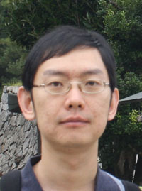
Paper info
Author
  Yue Zhang
    http://people.sutd.edu.sg/~yue_zhang/index.html
    Assistant professor at SUTD
    Research interest:
      ML based NLP
      Web information extraction
      Financial market prediction
NLP Presentation By Fang Wenjing
Notes:
Singapore University of Technology and Design(SUTD)

Slide 4
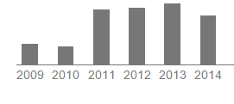
Paper info
Author
EMNLP in 2008
Citation: 131 times in total
NLP Presentation By Fang Wenjing

Slide 5
Paper info
Author
EMNLP in 2008
Citation: 131 times in total
Contribution
  3 Beam-search decoders
  State-of-art accuracy
    86.2% on Chinese Penn Treebank
    92.1% on English Penn Treebank
NLP Presentation By Fang Wenjing

Slide 6
Content
Paper info
Background knowledge
General idea
Framework
Experiment
Background
Dependency tree
Graph-based parse
Transition-based parse
NLP Presentation By Fang Wenjing

Slide 7
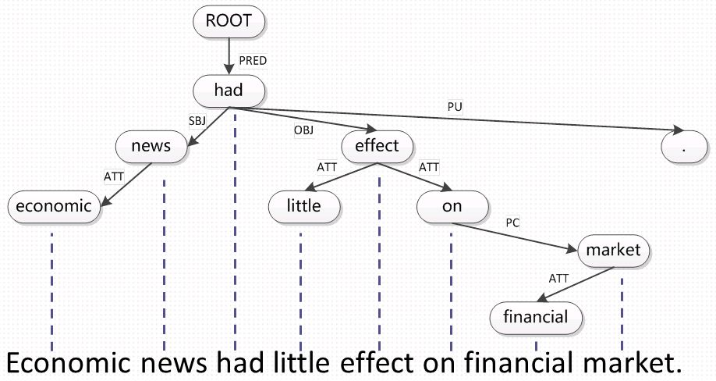
Dependency Tree
Syntactic tree
Node: words
Arc: head-dependent relation
NLP Presentation By Fang Wenjing

Slide 8
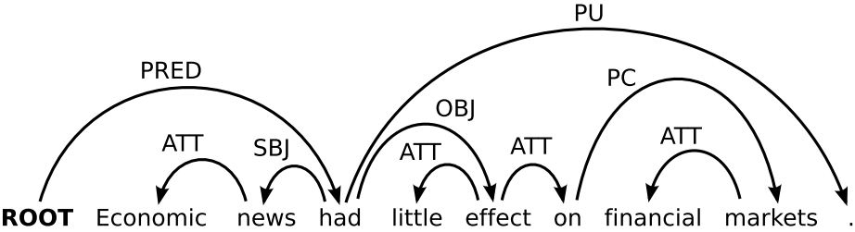
Dependency Tree
Syntactic tree
Node: words
Arc: head-dependent relation
NLP Presentation By Fang Wenjing

Slide 9




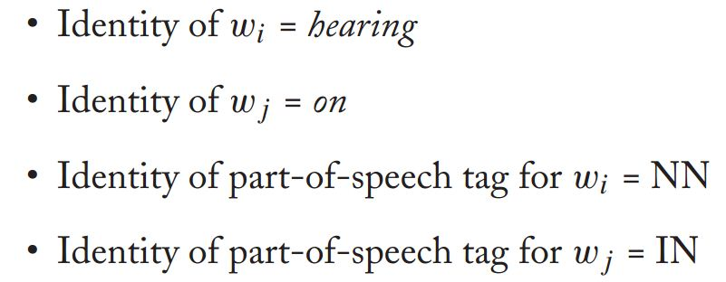
Graph-based
Scorer: arc-factor model
Score of arc:
From wi to wj
Relation is r
Weight
vector
pre-defined features
converted to binary vector
NLP Presentation By Fang Wenjing

Slide 10
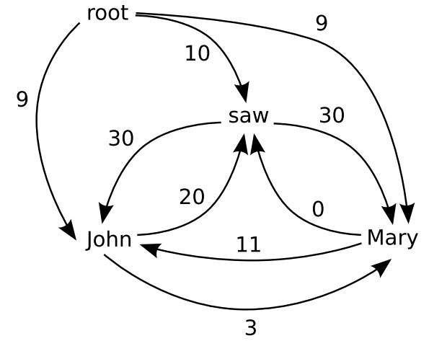
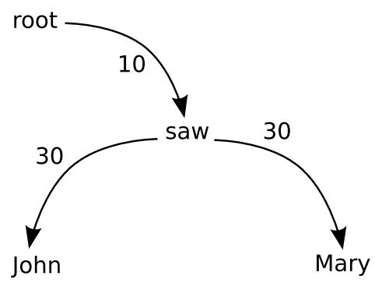

Graph-based
Scorer: arc-factor model
MST: max spanning tree
NLP Presentation By Fang Wenjing

Slide 11
Transition-based
State + transition
  Stack σ, Buffer β, Arc-set A
  SH, LA, RA
  left-to-right
ML classifier to get transition
  Feature
  Action sequence
NLP Presentation By Fang Wenjing

Slide 12
Content
Paper info
Background knowledge
General idea
Framework
Experiment
General
MST V.S. Malt
Beam intuition
NLP Presentation By Fang Wenjing

Slide 13
MST V.S. Malt
MST
  Score arc
  Exhaustive search
  Limited feature by DP
Malt
  Score action
  Greedy transition
  Parsing history feature
NLP Presentation By Fang Wenjing

Slide 14
Intuition
Flexibility of graph-based parsing features
Add search to transition-based parsing
Combine two parsing approaches
Idea of beam: limit number of partial parse
NLP Presentation By Fang Wenjing

Slide 15
Content
Paper info
Background knowledge
General idea
Framework
Experiment
Framework
Graph-based beam
Transition-based beam
Combined beam
NLP Presentation By Fang Wenjing

Slide 16
Graph-based beam
Search
  Left-to-right
  One arc per step
  Expand arc in all possible ways
  Item, output, agenda
Item: 2->1
Output:
a. 2->1 + 2->3
b. 2->1 + 1->3
c. 2->1 + 3->2
Agenda: (b=2)
a. b. (new item)
I
1
love
2
you
3
.
4
I
1
love
2
you
3
.
4
NLP Presentation By Fang Wenjing
Notes:
agenda – the beam for state items
item – partial parse tree
output – a set of output items

Slide 17
Graph-based beam
Search
  Expand arc in all possible ways
  One arc per step
  Left-to-right
Prune
  Graph-based scorer
  Select b best
NLP Presentation By Fang Wenjing

Slide 18
Transition-based beam
Search
  Action in transition-based
  Take all possible transition
Prune
  Score transition
  Feature based on transition and context
NLP Presentation By Fang Wenjing

Slide 19
Combined beam
How to apply info of both methods ?
  Build a parse tree incrementally
  Different scoring models
  Different process
NLP Presentation By Fang Wenjing

Slide 20
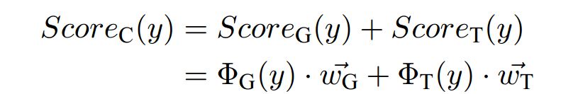
Combined beam
How to apply info of both methods ?
Sum up sub models: Arc in parse state !
  Union of feature templates in both model
  Transition-based decoder
NLP Presentation By Fang Wenjing

Slide 21
Content
Paper info
Background knowledge
General idea
Framework
Experiment & Further
NLP Presentation By Fang Wenjing

Slide 22
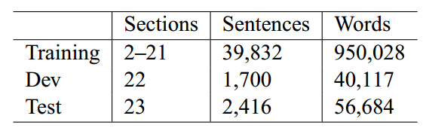
Experiment
Copora: English & Chinese Penn Treebank
NLP Presentation By Fang Wenjing
Notes:
Projective: PTB WSJ sections 2-21 for training, 22 for development, and 23 for evaluation
Non-projective: CoNLL share task 2006

Slide 23
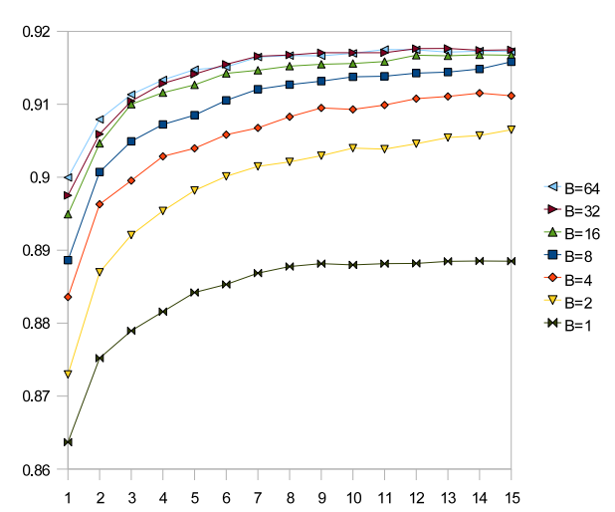
Experiment
Copora: English & Chinese Penn Treebank
Beam size B
  Transition-based
  X-axis: training iterations
  Y-axis: word precision
  B=64, highest result
  Slow down speed
  Imporve accuracy
NLP Presentation By Fang Wenjing
Notes:
Projective: PTB WSJ sections 2-21 for training, 22 for development, and 23 for evaluation
Non-projective: CoNLL share task 2006

Slide 24
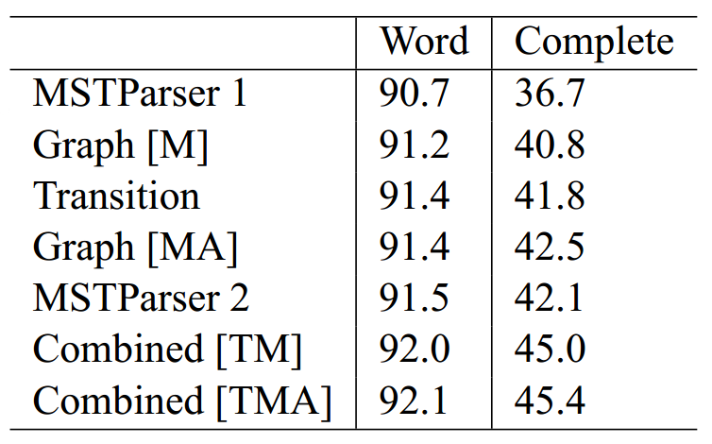
Experiment
Copora: English & Chinese Penn Treebank
Beam size B
Accuracy comparison
  Graph[M] v.s.MST-2ord
  Graph[MA] v.s.MST-2ord
  2 feature differs a lot
MSTParser 1: 1 order mst
MSTParser 2: 2 order mst
Graph[M]:beam graph
Graph[MA]: beam graph
with additional features
Transition:beam transition
Combined[TM]:mst feature
Combined[TMA]:additional feature
NLP Presentation By Fang Wenjing
Notes:
Projective: PTB WSJ sections 2-21 for training, 22 for development, and 23 for evaluation
Non-projective: CoNLL share task 2006

Slide 25
Summary
Agenda + beam
  Generate multiple partial parse tree
  Pick b with the highest confidence
Combine graph-based & transition-based
Downside
  Training time & parsing time
  Fixed beam size
NLP Presentation By Fang Wenjing
Notes:
MST: accuracy loss, speed up
Malt: slow down, higher accuracy
Transition-based: fast & greedy
generate multiple transition sequences given a sentence, and pick one with the highest confidence.
Agenda stores at partial parsed trees(number limited by beam size)

Slide 26
Q & A
NLP Presentation By Fang Wenjing

Slide 27
Thank you !
NLP Presentation By Fang Wenjing

Slide 28
Selectional branch
Motivation:Greedy Speed+Beam Accuracy
  Greedy Transition-based(Nivre, 2008)
    Fast: Projective O(n) and non-projective O(n2)
    Rich feature
    Accurate: than graph-based
  Beam search(Zhang and Clark, 2008)
    Fix up greedy parsing
    State-of-art transition-based
    Downside: fixed beam number
NLP Presentation By Fang Wenjing
Notes:
skip tokens violating projectivity, expected linear time, amount of nonprojective dependencies is notably smaller
define features over a rich history of parsing decisions.
a greedy parser performs as accurately as a parser that uses beam search for about 64% of time

Slide 29
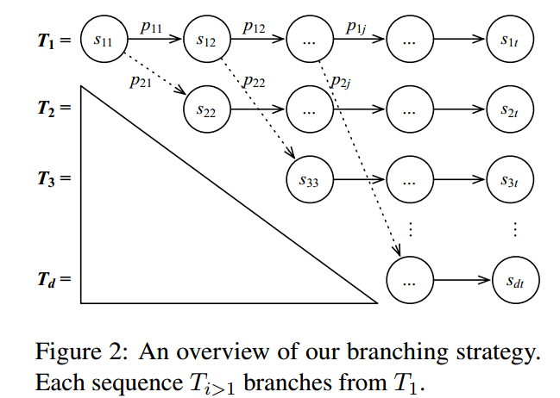
Selectional branch
T: transition
  T1: greedy parser
  Ti: transition sequence
s: state
  sij: jth transition in ith
  sequence
p: prediction
  Pkj: pth best prediction
  given s1j
Correction & inherit
NLP Presentation By Fang Wenjing
Notes:
Overview picture
Different from beam: beam from whole search space(this work just fix greedy output)
adaptive beam

Slide 30
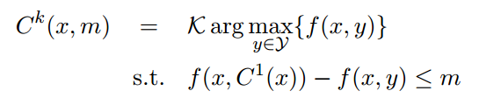
Confidence
Classifier: logistic regression
K-best prediction for low confidence
NLP Presentation By Fang Wenjing

Slide 31

Confidence
Classifier: logistic regression
K-best prediction for low confidence
Define low confidence prediction: margin
NLP Presentation By Fang Wenjing
Notes:
margin(threshold of best vs others) a prediction is considered not confident
If all margins are greater than a threshold, the best prediction is considered highly confident

Slide 32
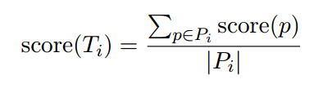
Confidence
Classifier: logistic regression
K-best prediction for low confidence
Define low confidence prediction: margin
Find best transition sequence
NLP Presentation By Fang Wenjing
Notes:
take the average instead of the sum of all prediction scores. This is because the algorithm does not guarantee the same number of transitions for every sequence

